Slide 1

Industry Project Presentation
on “DEVS TREE”
By
Name : Anuj jani
Enrollment No:21162102003
Institute of Computer Technology, Ganpat University
Date:30-4-2024
Prof Umang Thakkar(internal)
Arat Patel (external)

Slide 2
Table of Contents
Introduction
Objectives
Scope
Requirement
Conclusion
Reference

Slide 3
Introduction
React JS is a popular JavaScript library for building user interfaces, particularly single-page applications. It was developed by Facebook and is now maintained by Facebook and a community of individual developers and companies.
One of the key features of React JS is its component-based architecture.it means it allows developers to build complex user interfaces by breaking them down into small, reusable components .
Each component can have its own state, props, and behavior, which makes it easy to manage and reuse them throughout the application.

Slide 4
Objectives
When working with React.js, setting clear objectives can help guide the development process and ensure that the project meets its goals effectively. Here are some common objectives when using React.js:
Component-Based Architecture: React JS lets developers build reusable and modular components, making it easy to manage complex user interfaces.In React JS, components are the building blocks that make up a user interface.
Virtual DOM: React JS uses a virtual DOM for fast and efficient rendering of components, improving performance and user experience
State Management: React JS enables state management for creating dynamic and interactive user interfaces.In React, the state is an object that stores data that can change over time. It represents the current condition of a component and controls its behavior.

Slide 5
Scope
React is a JavaScript library for building UIs in web apps. Developed by Facebook, it's known for its efficient handling of UI elements. React uses components, a virtual DOM, and a declarative approach to simplify UI development, making it easier to build and manage complex UIs. State management tools like Redux or MobX help keep the app's state consistent and easy to manage.
React also has routing libraries for building multi-page web apps and testing tools for ensuring that components work as expected. Overall, React is a popular choice for UI development due to its powerful features and ease of use.
In a React app, state is usually managed by individual components. However, when an app becomes more complex, managing state in individual components can become difficult.Redux provides a centralized location for managing state, making it easier to track and update state throughout the app.

Slide 6
Requirement
HTML CSS JavaScript

Slide 7


Week1
HTML CSS

Slide 8
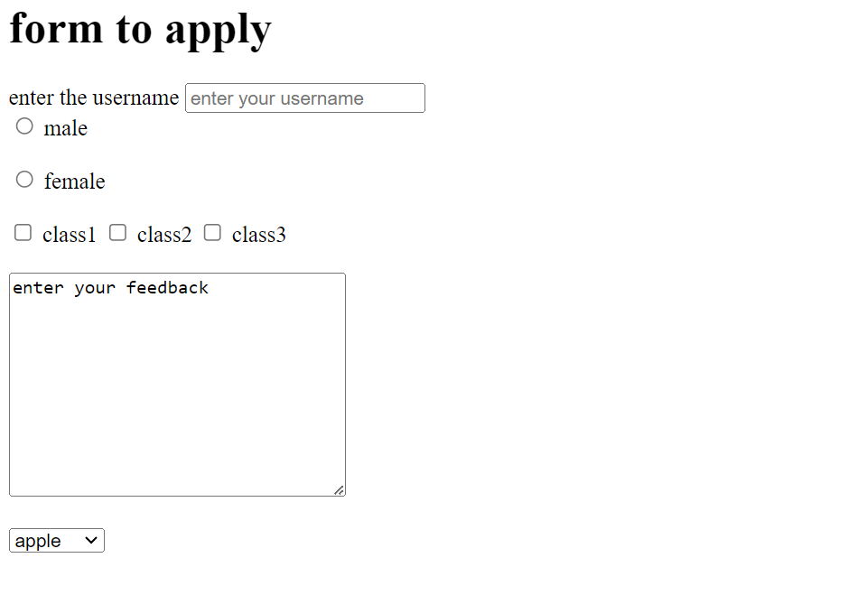

Slide 9

Week 2
Variables
DATA types
Data type conversion
Why string to number

Slide 10
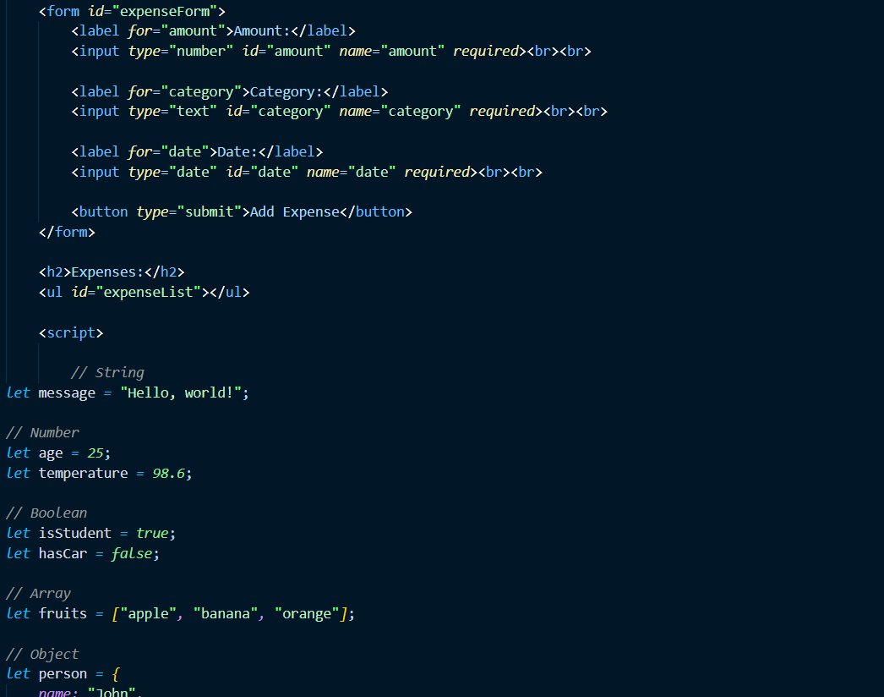
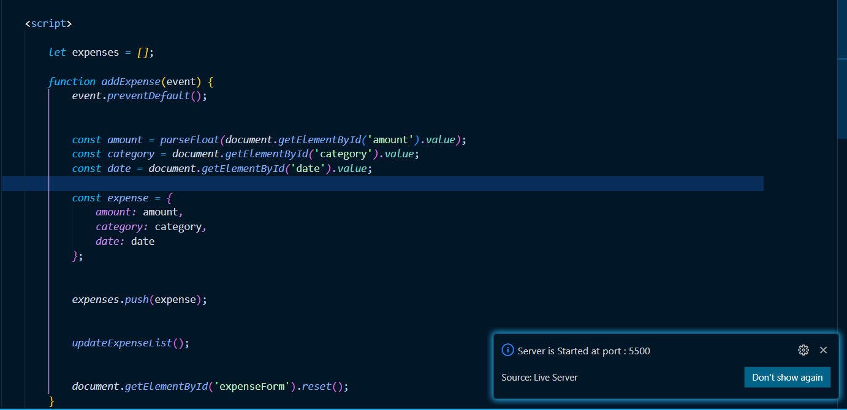
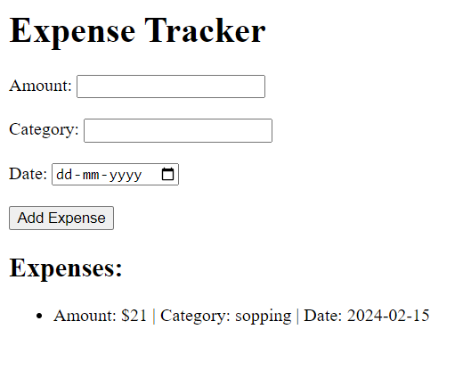
OutPut

Slide 11
Week 3
stack
strings
number and maths
Date and time

Slide 12
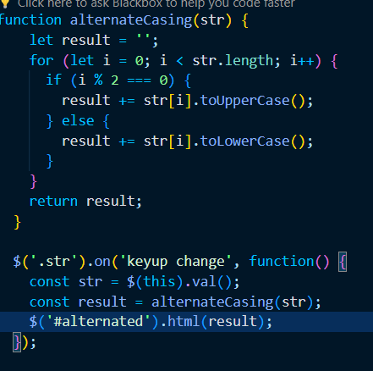
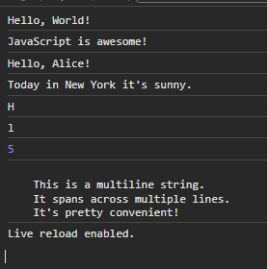
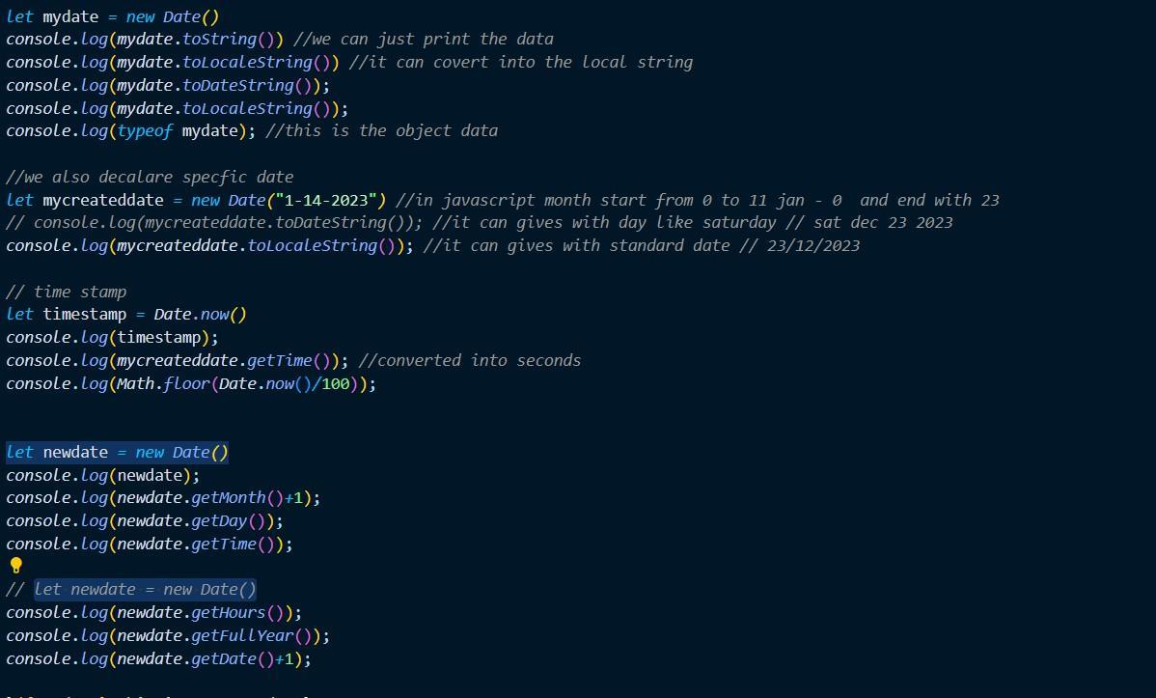
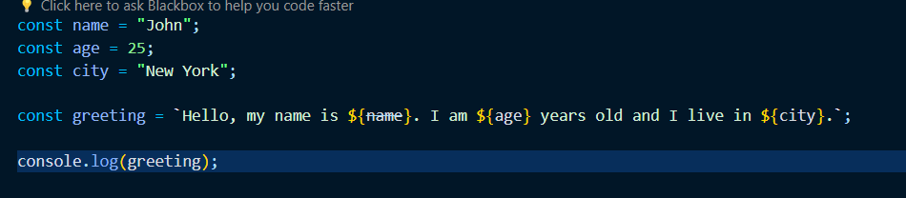
OutPut

Slide 13
Week 4
Array
Array method
Object
Function

Slide 14
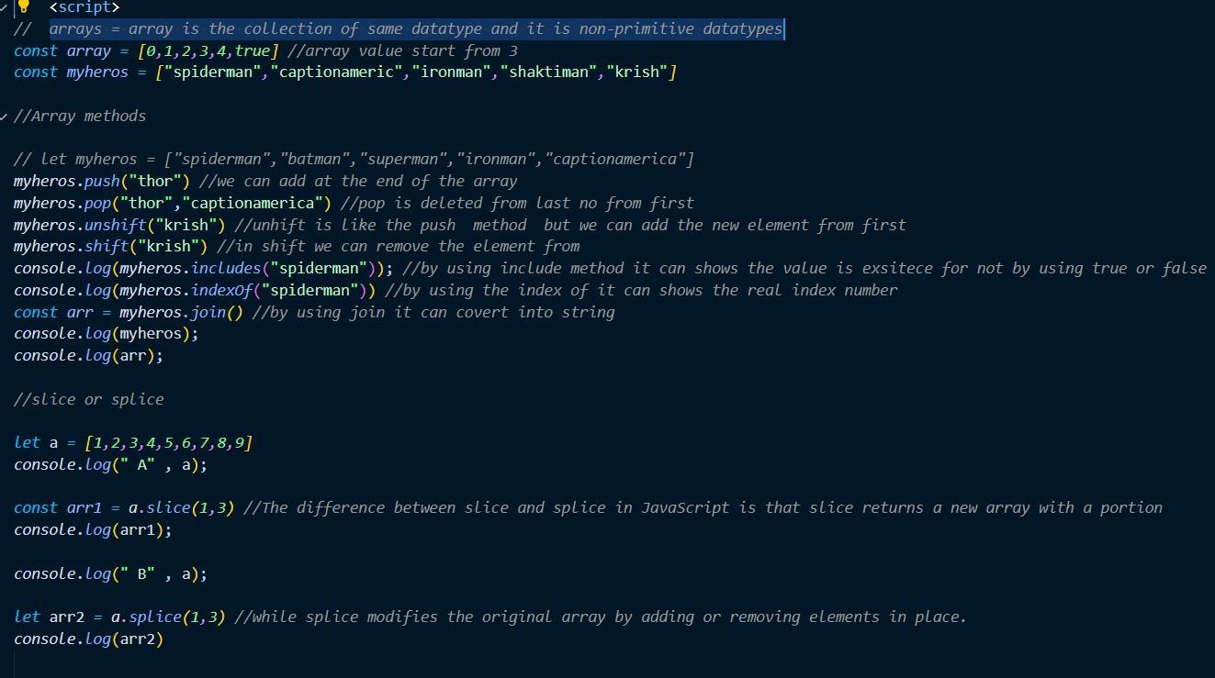
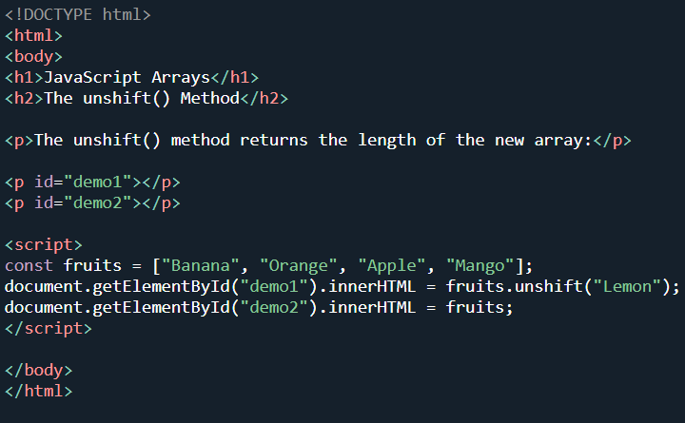
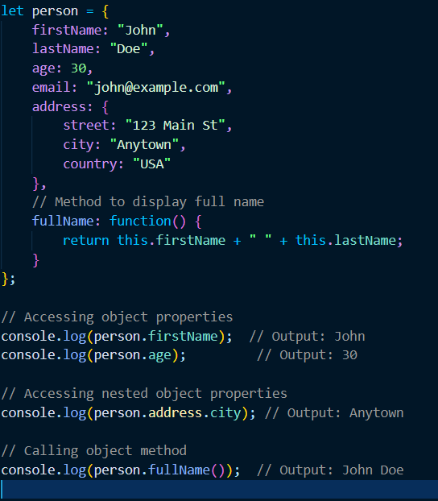
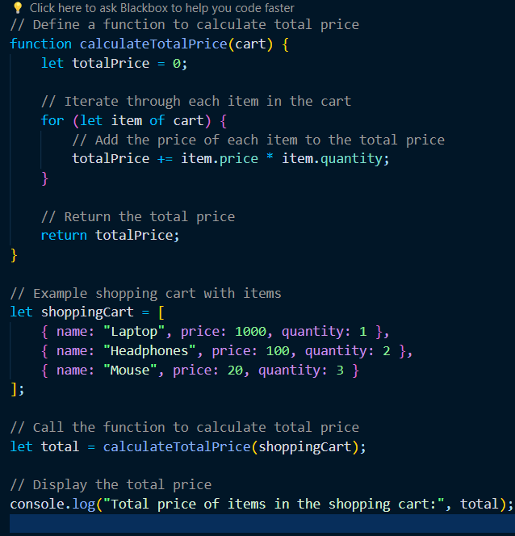

Slide 15
Week 5
Function with objects
Global and Local scope
loops (for , while)
loops (for , while,for each)

Slide 16
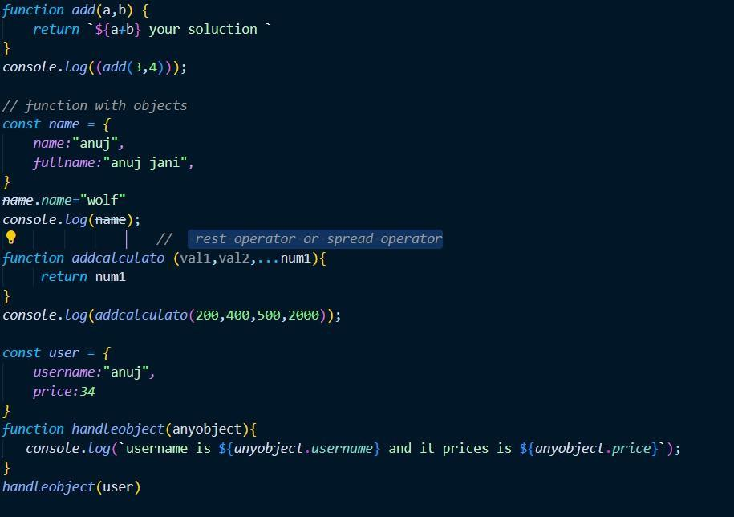
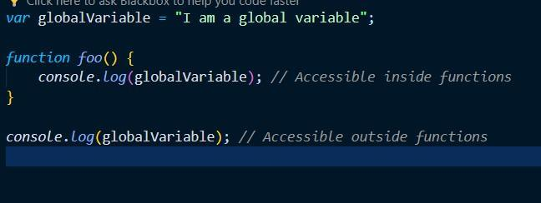
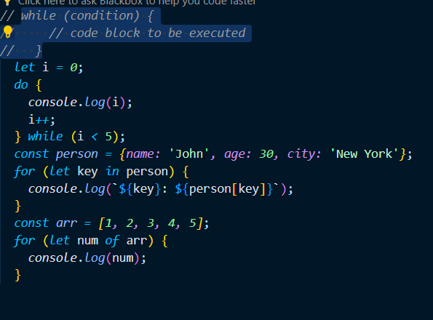
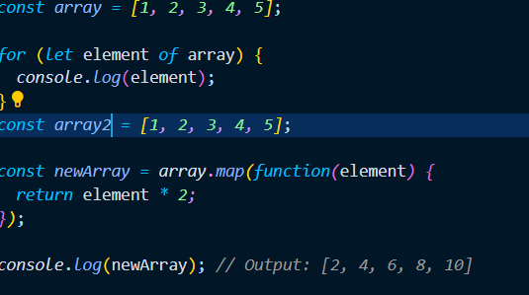

Slide 17
Week 6
Object and Destructuring
This and arrow function
control flow
map reduce and filter

Slide 18
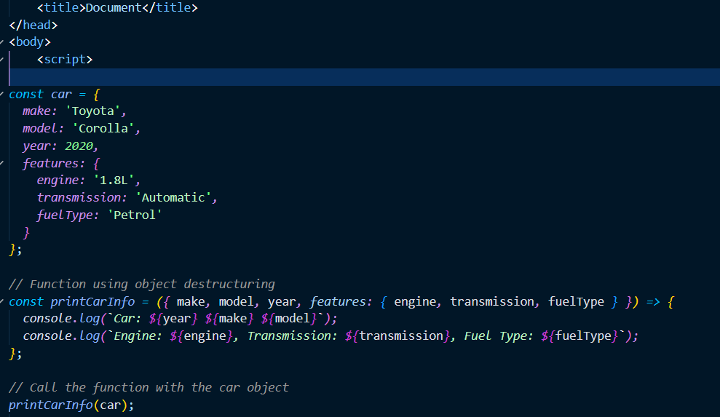
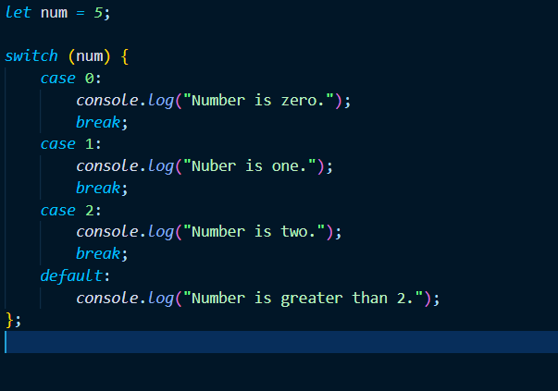
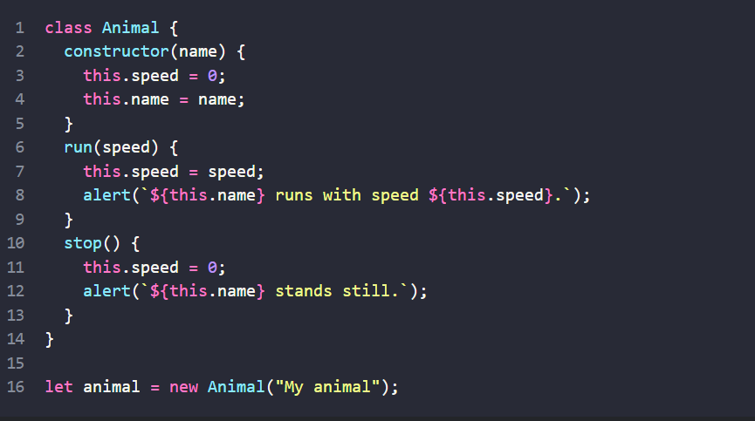
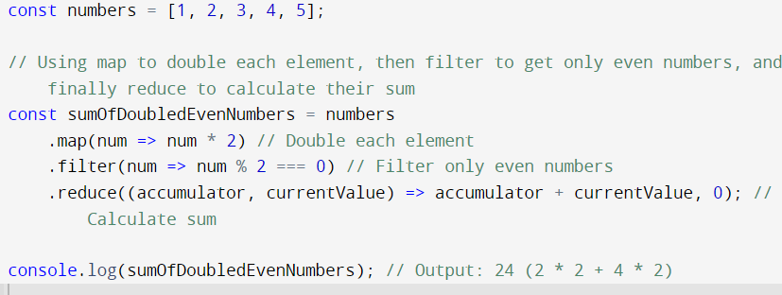

Slide 19
Week 7(2nd review)
Dom manipulation Part
Events
callbacks and promis
Aysic ,and fetch apis

Slide 20
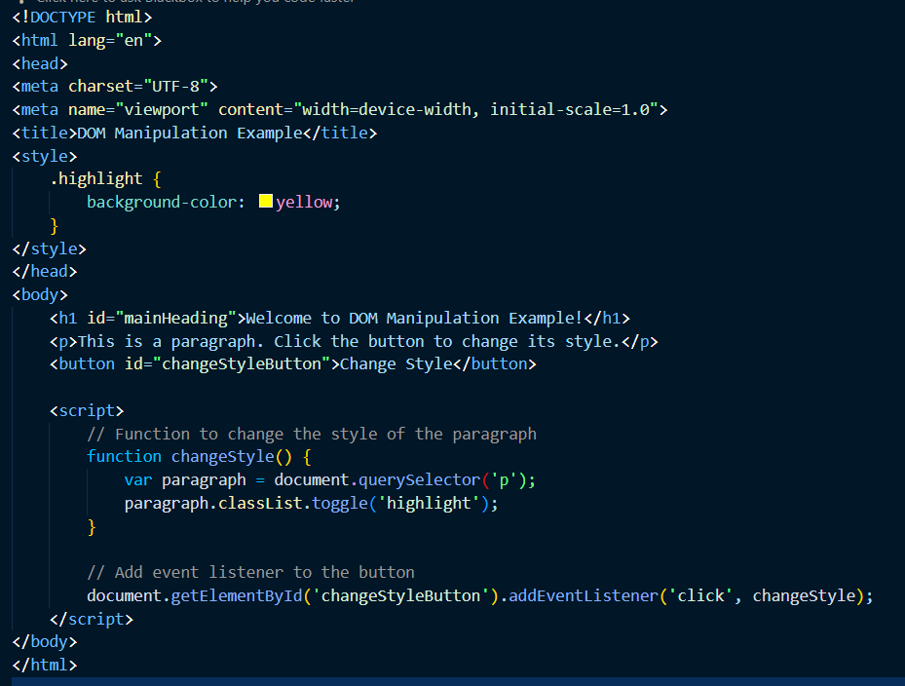
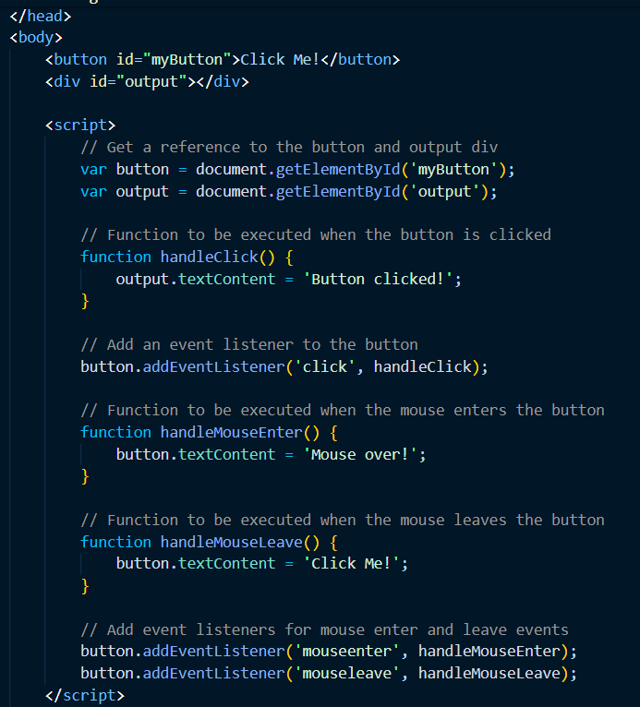
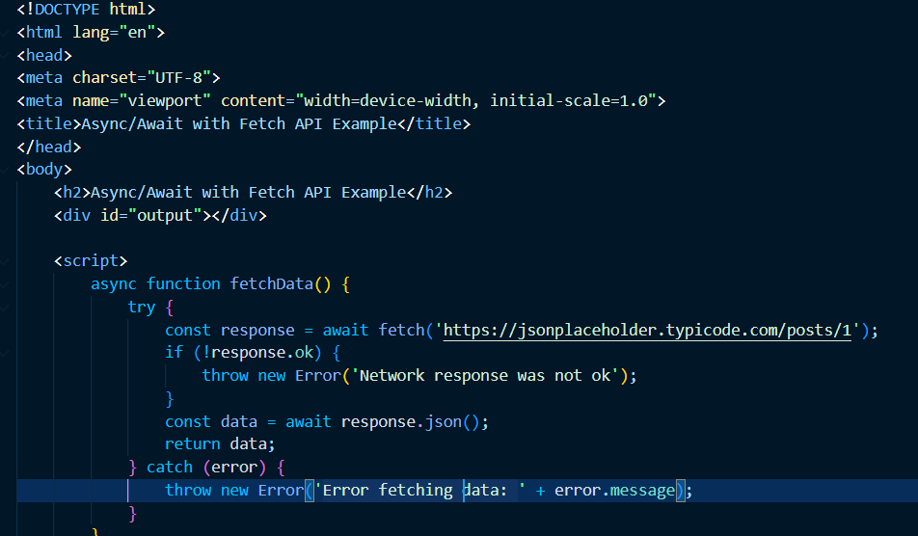
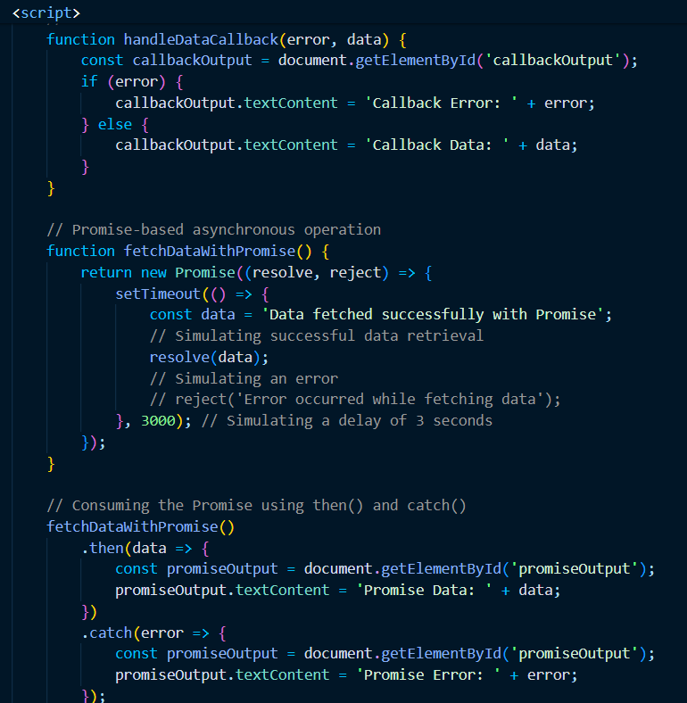

Slide 21
Week 8
classes and objects
try and catch
advances javascript

Slide 22
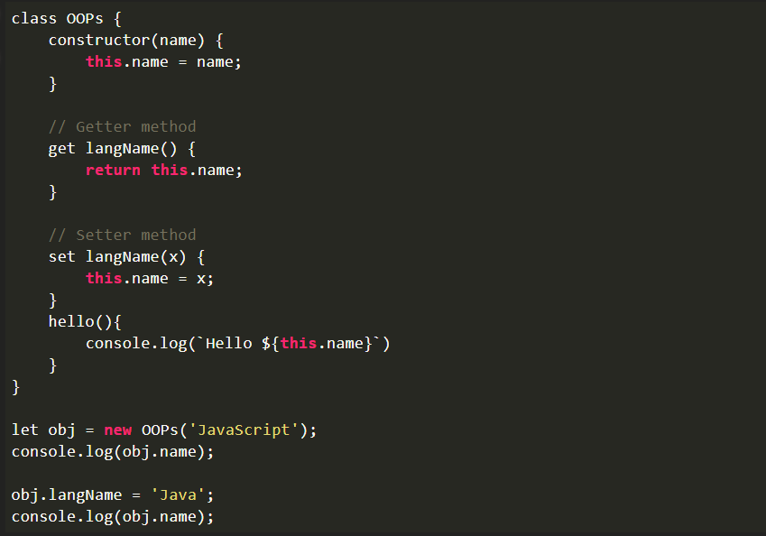
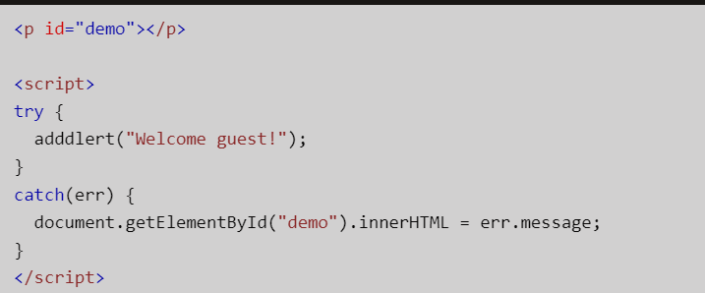
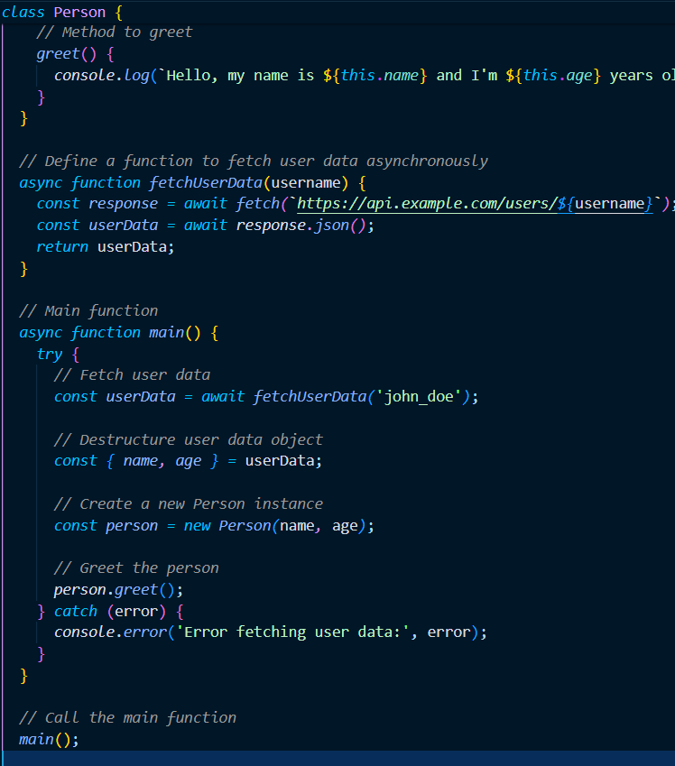

Slide 23

Week 9
Introduction to The React js
learn about React js file structure
Importing and exporting the components
Props

Slide 24
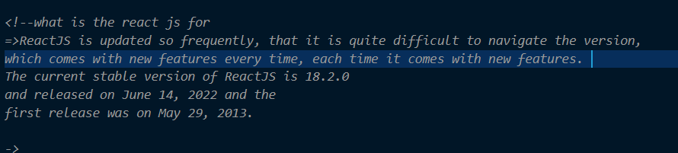
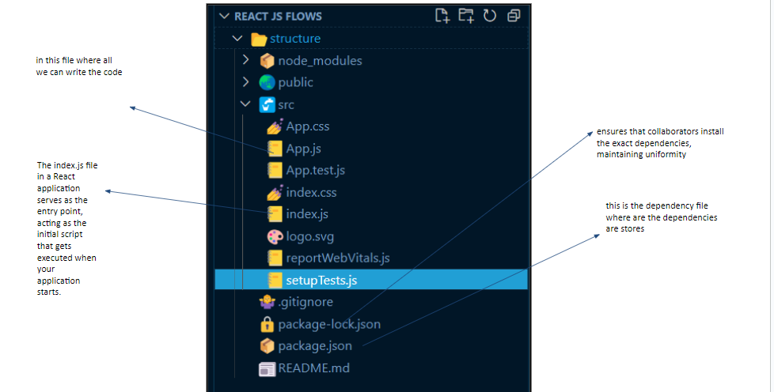
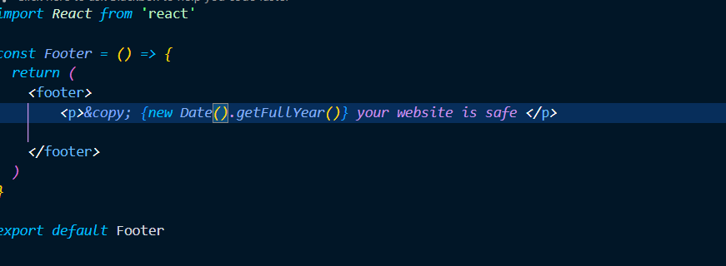
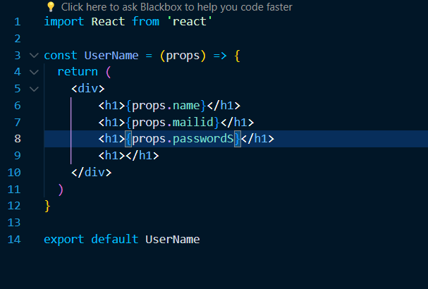
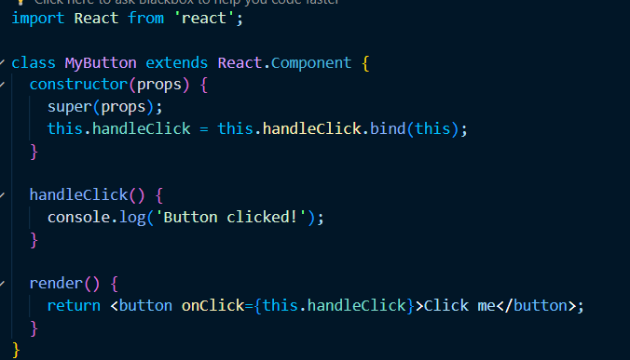

Slide 25
Tools and technology
Tools = vscode , Rapid Api , Freepeak , Icons8
Technology = html , css , javascript , react js

Slide 26
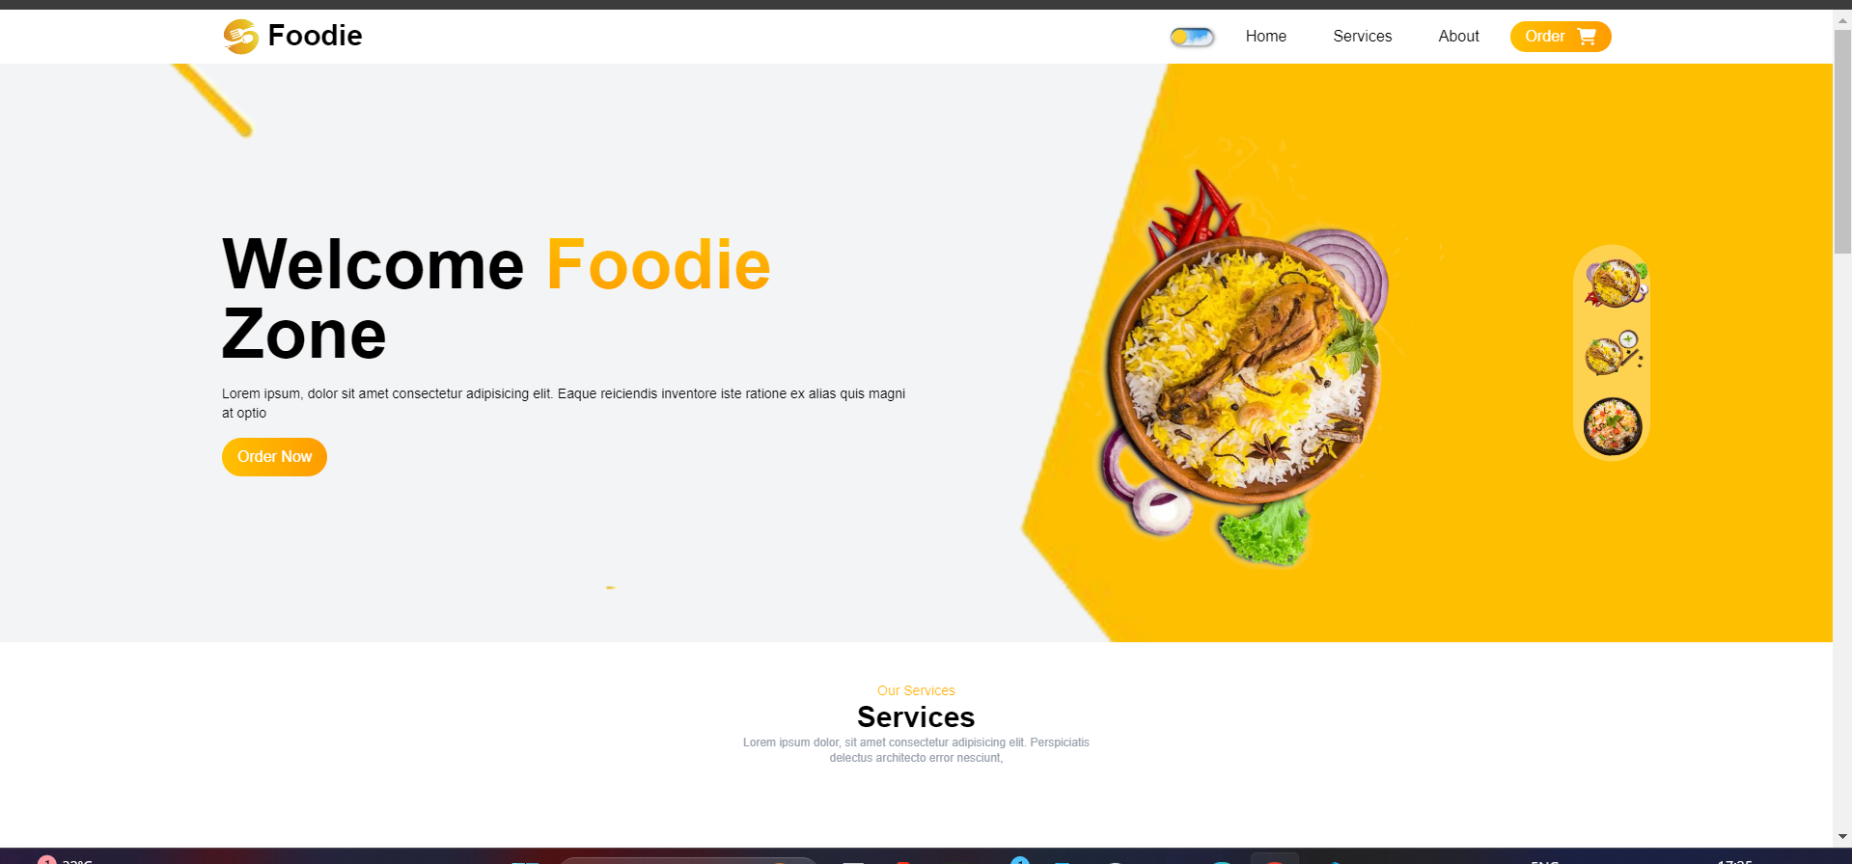
Food Website(ui)

Slide 27
Week 10
Conditional Rendering
Rendering
Events
Understanding Tailwind Css
start working on the food-ui

Slide 28
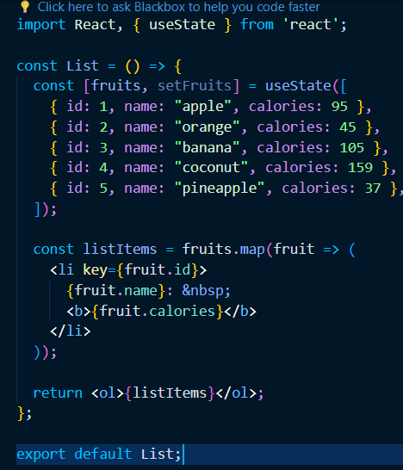
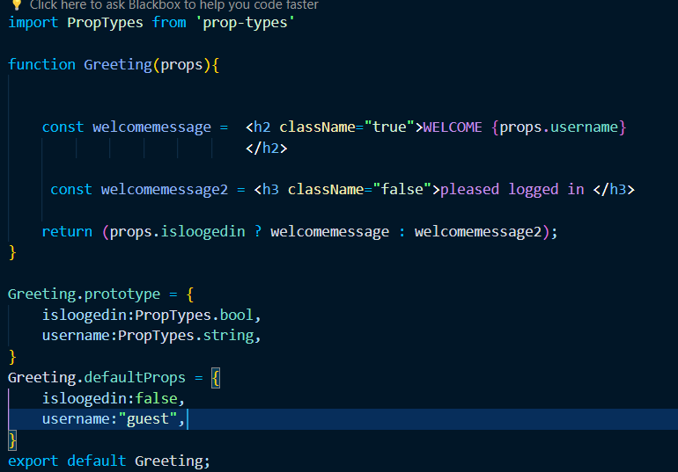
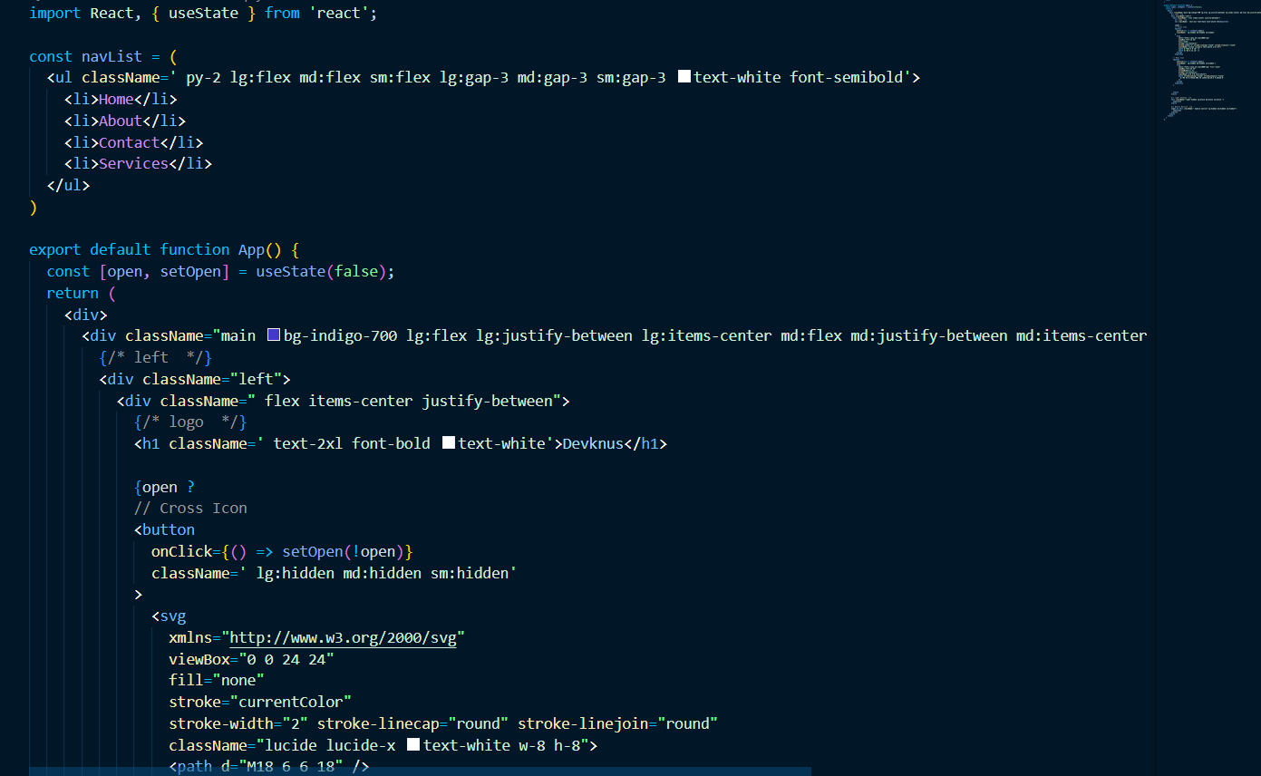

Slide 29
Week 11
States and hooks
UseEffect
Navbar
darkmode

Slide 30
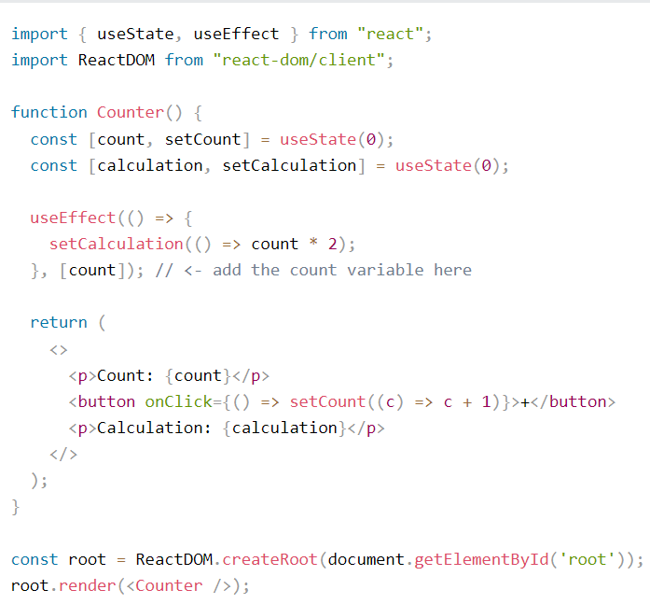
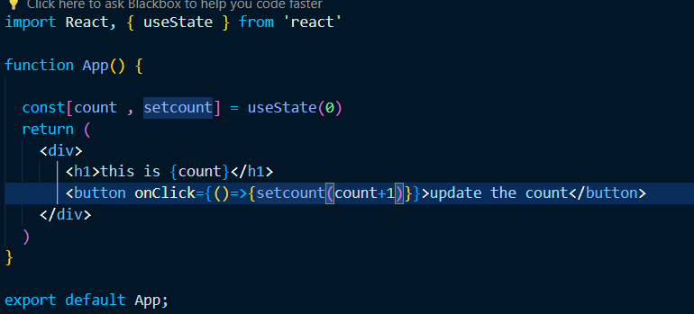


Slide 31
Week 12
Use Ref
handling the events in react
Working on the hero-section of Foodi ui
Working on the Services section of Foodi ui

Slide 32
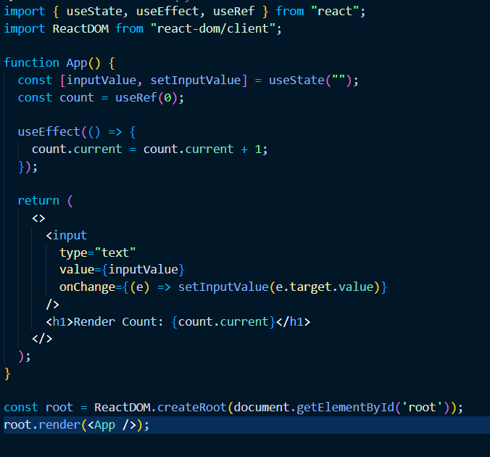
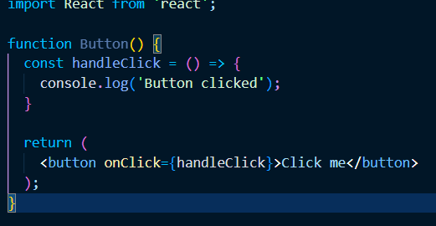

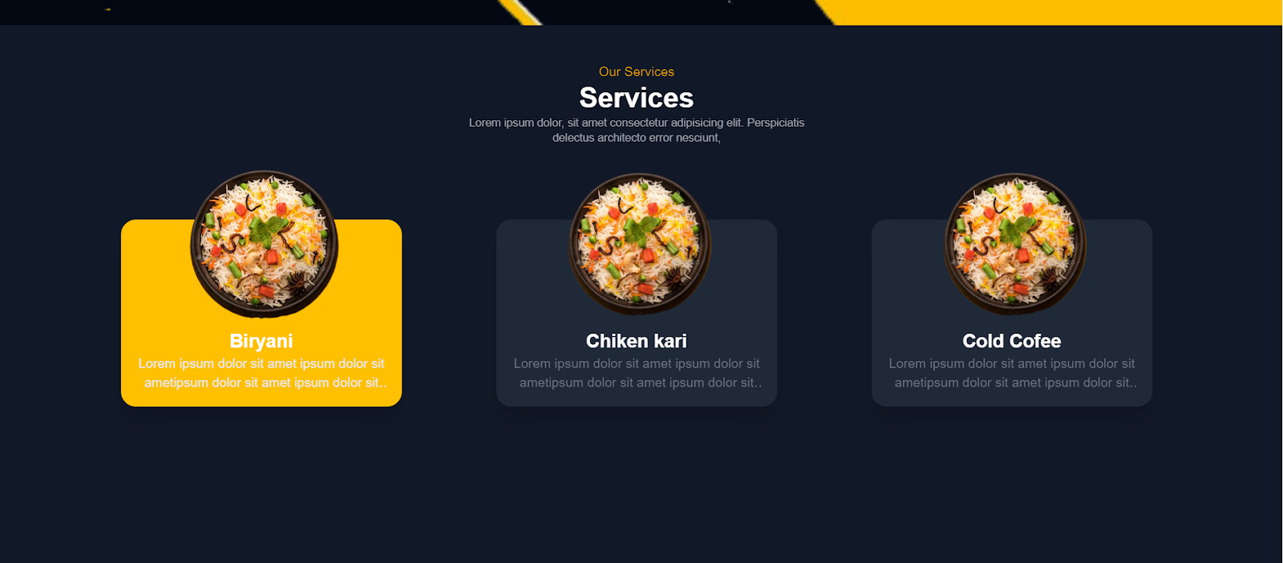

Slide 33
Foodi-website (Tools and Technology)
Tools = vscode , live preview , prettier code formatter , ES7+ React/Redux/React-Native snippets
Technology = Html , CSS , Javascript , react js , Tailwind Css

Slide 34
Objectives
→ Browse a list of food items and view details about each item, including ingredients and nutritional information.
→ Filter the food items by category (e.g. breakfast, lunch, dinner, snacks).
→ Search for specific food items by name or keyword.
→ Add food items to a shopping cart and view the total cost.
→ Checkout and place an order for delivery or pickup.

Slide 35
Scope
→ The project will be a simple webpage design that displays a list of food items.
→ The webpage will be built using React.js and its components.
→ The food items can be filtered by category, such as breakfast, lunch, dinner, or snacks.
→ Users can search for food items by name or keyword.
→ The food items can be added to a shopping cart and users can view the total cost.

Slide 36
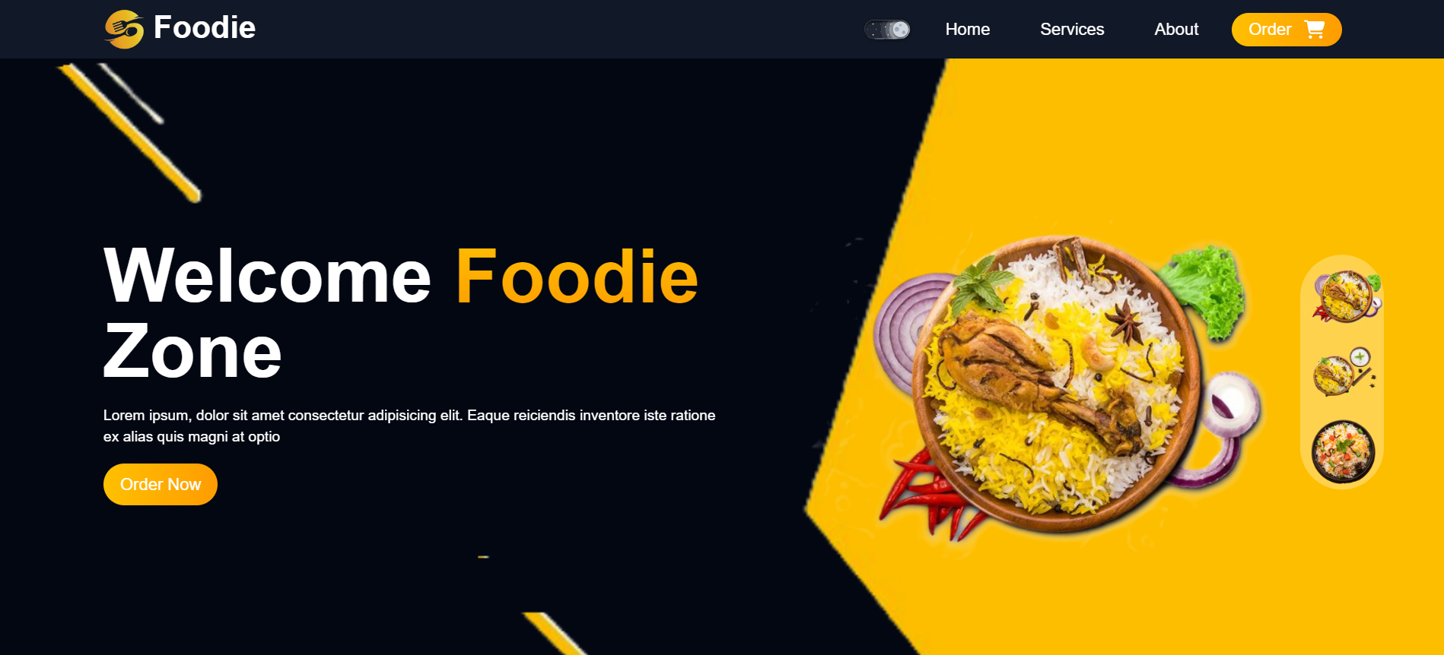
Nav Bar With dark-mode

Slide 37

Hero section

Slide 38
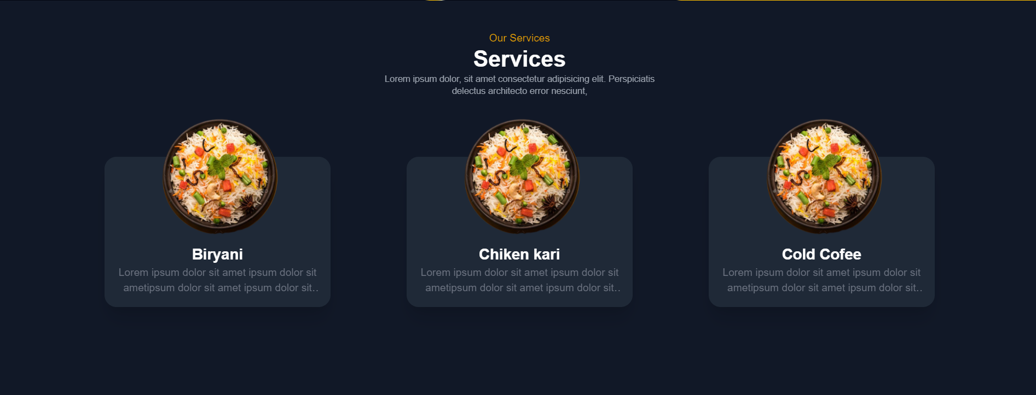
Services-section

Slide 39
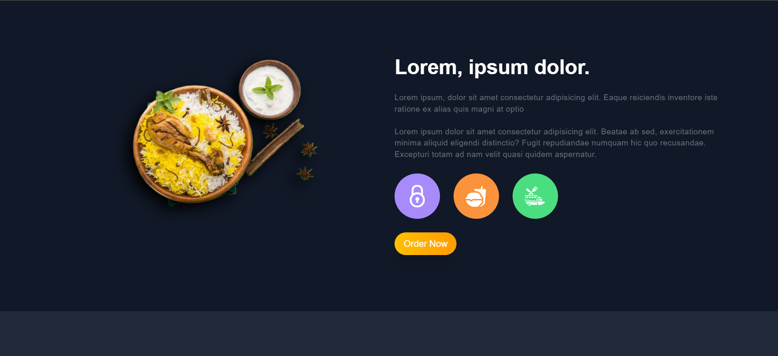
Description

Slide 40

Feedback

Slide 41
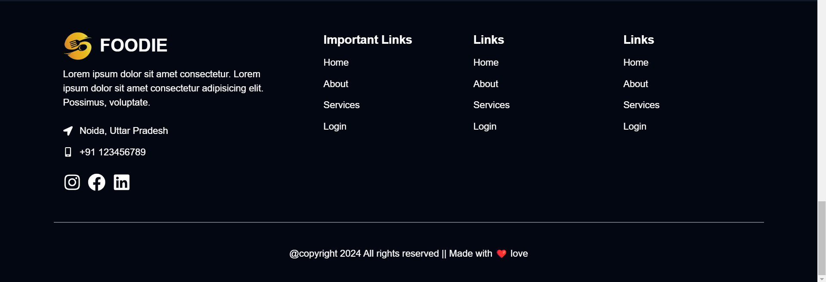
Footer-section

Slide 42
Future-work
→ User Authentication: Implement user authentication for users to create accounts, save their favorite food items, and view their order history.
→ Promotions and Discounts: Add a feature to offer promotions and discounts to users to incentivize them to make purchases.
→ Order Customization: Add a feature to allow users to customize their food items, such as adding or removing toppings or selecting different types of bread.

Slide 43
Week 13
React Router
Context-hook
Working on the Feedback and footer-section of
food ui (wrapping up the project)

Slide 44
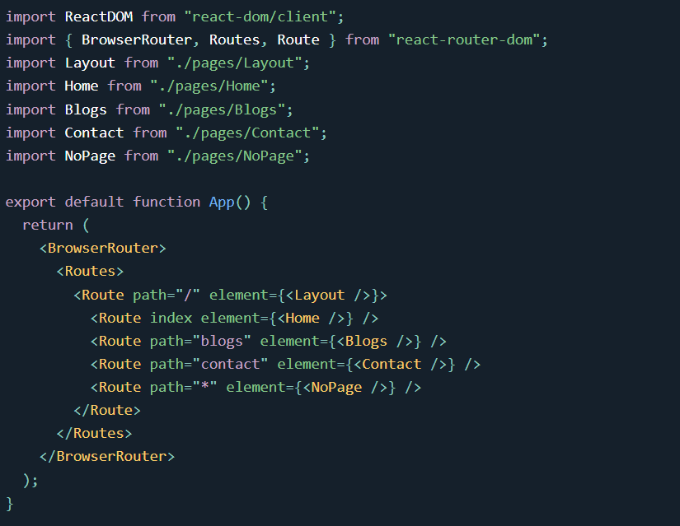
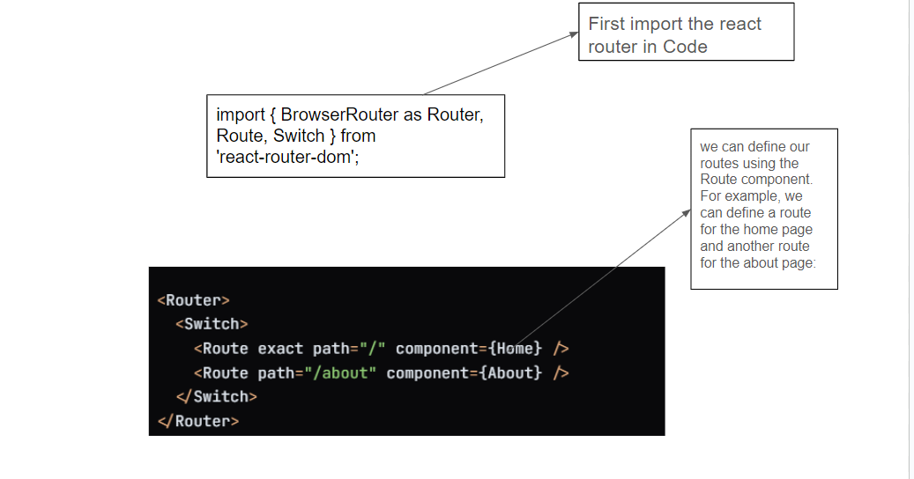
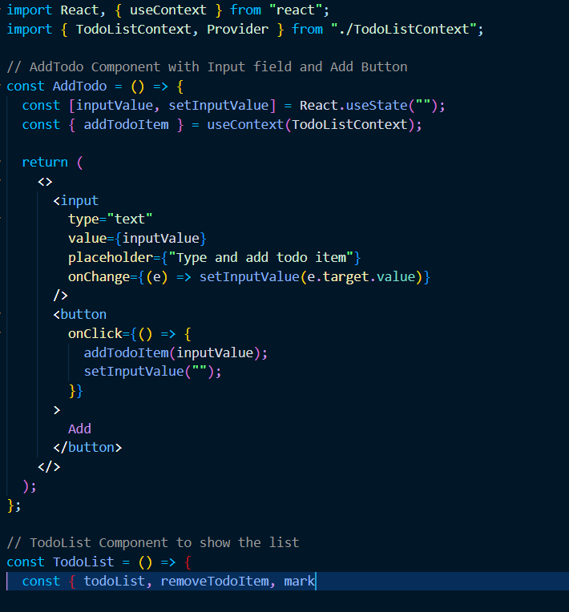
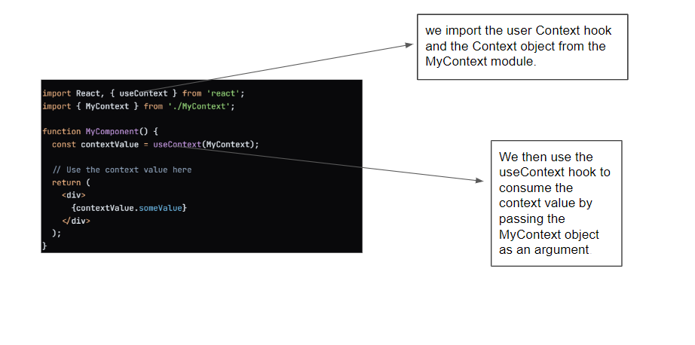
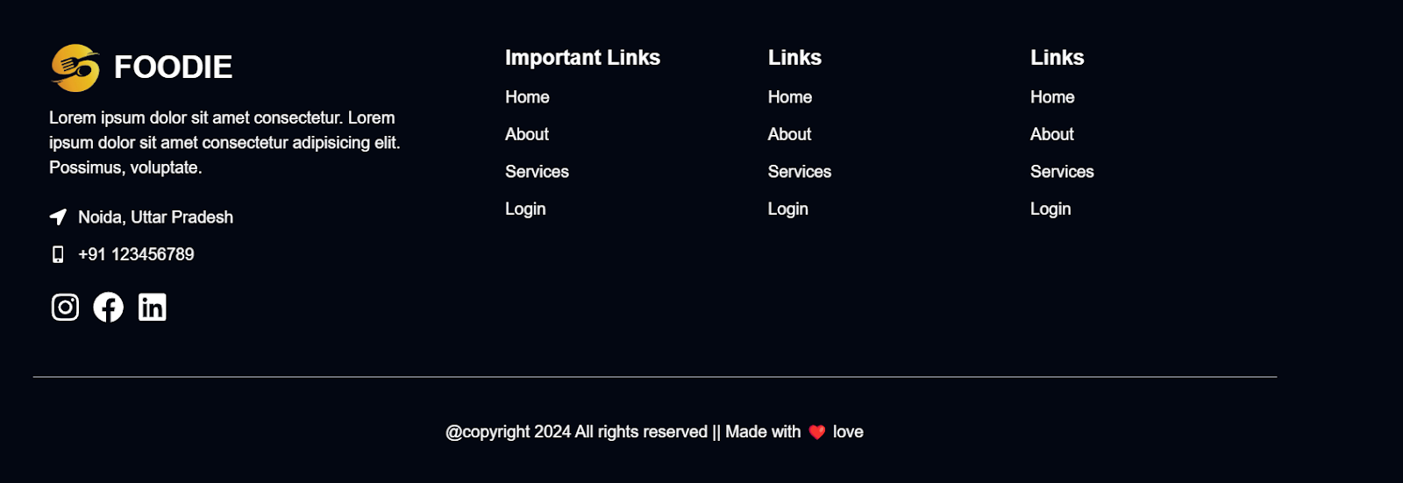


Slide 45
Brainwave website(Tools and Technology)
Tools = vscode , live preview , prettier code formatter , ES7+ React/Redux/React-Native snippets
Technology = Html , CSS , Javascript , react js , Tailwind Css , and basic css

Slide 46
Scope
The goal of this project is to build a modern AI app landing page called Brainwave. The landing page will feature a beautiful hero section with different shapes reacting to the cursor, a navigation bar with a colorful button that transforms into an animated hamburger menu on smaller screens,
and a subtle smooth scroll Parallax effect that moves elements down as the user scrolls. The landing page will also include sections for services, patterns, web development layout, pricing, and a roadmap.
The design is inspired by the popular Bento Box layout used by companies like Apple, Linear, and Clerk. The landing page will be fully mobile responsive and built using modern front-end development practices.

Slide 47
Objectives
Brainwave AI app landing page project is a SaaS (Software as a Service) based project. Specifically, it is a modern AI app landing page that showcases the developer's skills in creating modern and creative web designs.
The landing page will be fully mobile responsive and built using modern front-end development practices, including React and Tailwind CSS.
The landing page will also include sections for services, patterns, web development layout, pricing, and a roadmap

Slide 48

Nav-bar

Slide 49

Hero-section

Slide 50

Working On the Pricing-section

Slide 51

Working On the Feature-section

Slide 52

Working On the Footer Section

Slide 53

Working on the Collaboration-section

Slide 54

Working on the How-to use -section

Slide 55
Future-work
As for future work, the project could be expanded to include more advanced features such as AI-powered personalization,
real-time analytics, and integrations with other SaaS tools.ClickUp for effortless project management Zendesk for live chats etc
dditionally, the project could be scaled to support multiple languages and currencies to expand its reach to a global audience.

Slide 56
Week 14
Use-Hooks
use-Callback hook
Start working on the new project
Brainwave (discussion)

Slide 57



Slide 58
Week 15
Navbar
Material - ui
Hero-section

Slide 59


Slide 60
Week 16
Understanding The Barchart.js
Working On the Pricing-section
Working On the Feature-section

Slide 61


Slide 62
Week 17
Working On the Footer Section
Working on the Collaboration-section
Working on the How-to use -section

Slide 64
Conclusion
In conclusion, this internship experience has provided valuable insights into the world of React.js development and its application in modern web development projects. Throughout the internship, various aspects of React.js were explored, including component-based architecture, state management, routing, and handling of asynchronous operations.
The hands-on experience gained through working on real-world projects has been instrumental in solidifying theoretical knowledge and honing practical skills. From building interactive user interfaces to optimizing performance and maintaining code quality, each task presented unique challenges and learning opportunities.

Slide 65
Reference
https://react.dev/
https://developer.mozilla.org/en-US/docs/Web/javascript
https://www.w3schools.com/
https://tailwindcss.com/docs/installation
s://www.chartjs.org/docs/latest/charts/bar.html
https://mui.com/material-ui/

Slide 66
Thank You !!

